Slide 1
REACTION OF PEOPLE DUE TO FAKE NEWS
Results in Github: https://github.com/sfrias/fake4news

Slide 2
https://www.digitaltveurope.com/comment/sex-lies-and-broadband/
Albert Pardo
Juan Pablo Delzo
Josep Romero
Santiago Frias
Josep M. Torrents

Slide 3
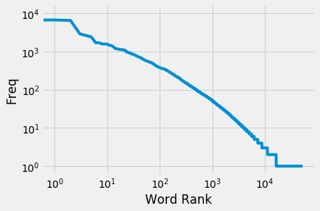
Word Frequency of the Datathon DataSet

Slide 4
most used words in data set related with fake news.
[('I', 10643),
("'s", 6723),
("n't", 6518),
('would', 2911),
('like', 2626),
('people', 2407),
('think', 1707),
('get', 1699),
("'re", 1579),
("'m", 1576)]

Slide 5
next step find those words related with fake news
counterfeit falsificacion red
fabricated (ojo, hay que contextualizar) red
forged falsificado red
fraudulent red
mock burlarse red
simulated yellow
artificial yelow
blamey red
authentic green
genuine green
real green
sincere green
true green
original green
truthful green
false falso red
feigned fingido yelow
fictitious yellow
gossip blue
tattle blue
coloquial thing green
junk basura red
pseudo news blue
bogus falso red
phony falso red
concocted confeccionado red
invented red
make-believe blue
sham falso red
soft-soap yelow

Slide 6
BLOOD WARNING

Slide 7
YELLOW STAY FOCUS on the SUNLIGHT

Slide 8
GREEN from apes age LEAVES TREE REFUGE

Slide 9
Genuine
Fictitious
False

Slide 10
Thank you for your attention

